Slide 1
QloudSync
Activity Flow - Download Sync

Slide 2
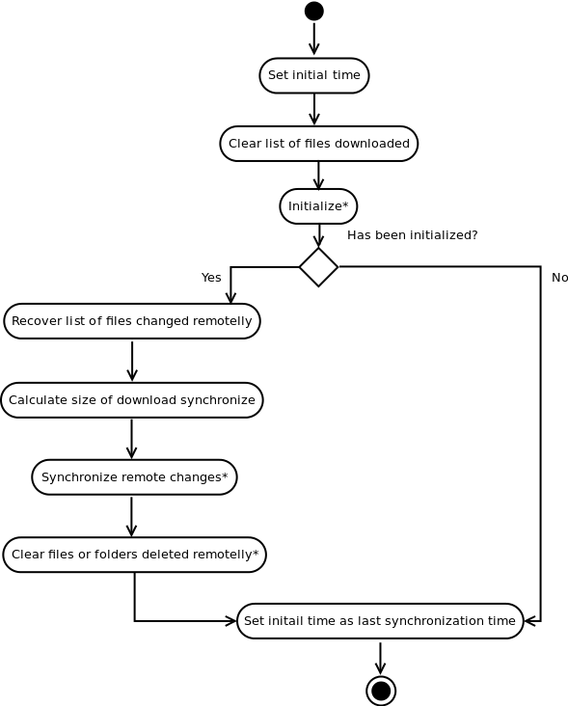
Main flow

Slide 3
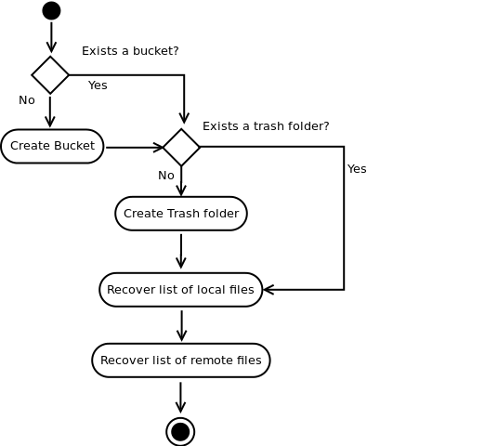
Initialize

Slide 4
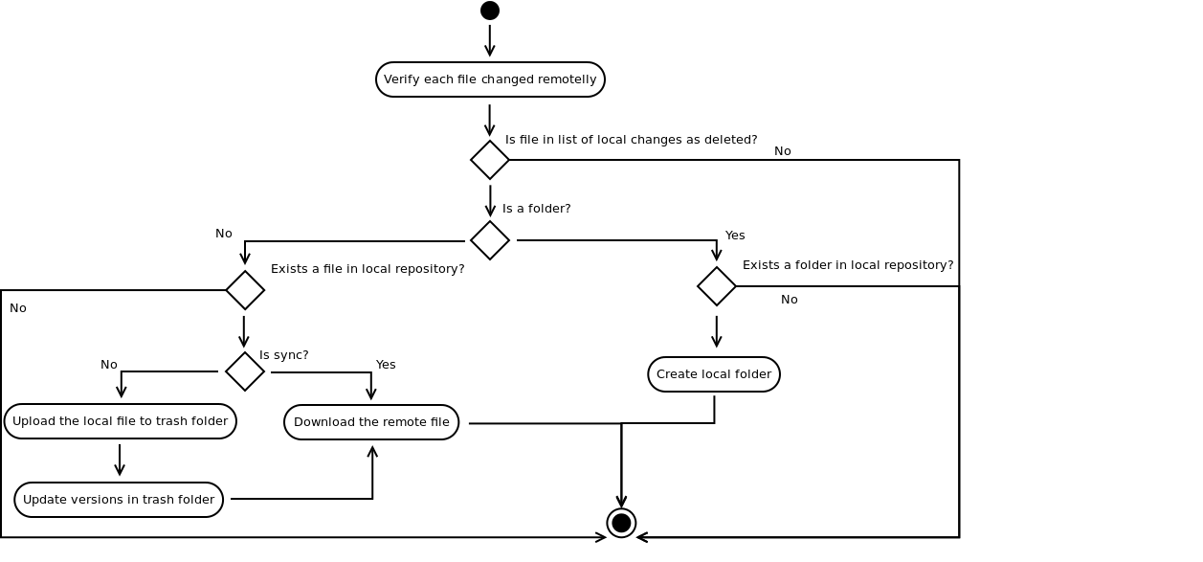
Synchronize Remote Changes

Slide 5
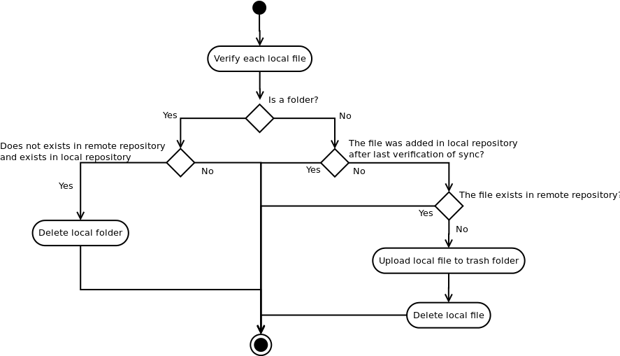
Clear file or folders deleted remotelly

